Slide 1
The God of the Heart
Romans 10

Slide 2
Rom. 9: God’s Hand in History
Abraham
Israel: God’s Revelation
JC: Incarnation of the Living God
The Gentile Age
Romans 9:25-27 As indeed he says in Hosea, “Those who were not my people I will call ‘my people,’ and her who was not beloved I will call ‘beloved.’” And in the very place where it was said to them, ‘You are not my people,’ there they will be called ‘sons of the living God.’”
And Isaiah cries out concerning Israel: “Though the number of the sons of Israel be as the sand of the sea, only a remnant of them will be saved”
Notes:
P=Traces Hist: ** Beg.w/ Abe (Skips B4)
**Israel=WOG → **Lead 2 JC → **“Gentile Age”
=EXPANSION of G’s Work→ “All Nations”
=the “Ecclesia” (= “Gatherings”)
**Hosea=1 of MANY x’s G Says.. (Ge.12=1st x)
“Sons..G” = a PROMOTION ovr “Sons..Abe”
**Israel=Rejects G’s Program &JC & Their Purp.
P’s Point: G=Has the RIGHT 2 Show “Favoritism”
(G ~Choose the PICTS!) & the RIGHT 2 Go BEYOND Israel

Slide 3
Rom. 9: God’s Hand in History
Angry Young McCallums
Picts were feared exhibitionists
…which wasn’t always bad.
Abraham
Israel: God’s Revelation
JC: Incarnation of the Living God
The Gentile Age
Notes:
P’s Point: G=Has the RIGHT 2 Show “Favoritism”
(G ~Choose the **PICTS = “My Brothers”
**=Naked / **~All Bad!)
& the RIGHT 2 Go BEYOND Israel
They ~DESERVE G’s Favor
Ch.11: Gentiles ~Deserve 2!

Slide 4
Rom. 9: God’s Hand in History
Romans 9:33 as it is written, “Look!
I am laying in Zion a stone of stumbling, and a rock of offense;
and whoever believes in him will not be put to shame.”
Personal Realm
God’s Realm
Notes:
“LOOK!” = 2 Facts = Interplay G/Personal
**MY Choice= “Whoever Believes…” = FREEDOM
** G’s Choice=“Rock…Offense…in JERUS” = LIMITS
**BOX=Where We “Setup” R THRONES/Kingdoms
=FORTRESSES! → “RSovereign FREE Will”
=Keeps **SHRINKING! → ~Let G. / Others In

Slide 5
Rom. 9: The Result in History
God’s Realm
MY Realm
Romans 9:30-31 What shall we say, then? That Gentiles who did not pursue righteousness have attained it, that is, a righteousness that is by faith; but that Israel who pursued a law that would lead to righteousness did not succeed in attaining that law.
Notes:
v.30-1 P=Concludes w/ SHOCKING Revelation!
b/c Rabbinic **Judaism=REVERSED G&My Roles
=**G-In-a-Box → =2Day’s View of G

Slide 6
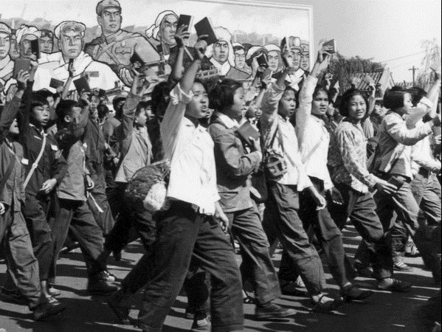
God-in-a-Box Syndrome
romans 10:1-2 Brothers, My Heart’s Desire And Prayer To God For [the Israelites] Is That They May Be Saved. For I Bear Them Witness That They Have A Zeal For God, But Not According To Knowledge.
Notes:
ZEAL != Right! → IL: **Commies=FANATICS
G ~OBEY U Just b/c You’re Fanatical!
“Knowledge” = #1 Issue → ~IDEAS/Imagination
Postmodern=RIGHT: Ur/My Ideas ~1 KNOWS
“ = WRONG: “G ~Communicate” =DOGMATIC

Slide 7

God-in-a-Box Syndrome
Romans 10:3 being ignorant of the righteousness of God…
Seeking to establish their own righteousness,
They did not submit to God’s righteousness.
Notes:
#1 = **=Self-Righteousness = WARS/Divorce
#2 = Utterly Alienating 2 G’s LOVE
“I ~CARE about Ur Love…I Hve Just Cause!”
IL: Fights = **Isolated BOXES: “MY Rules…”

Slide 8

God’s Answer…
Which means…
Romans 10:4 Christ is …
the end of the law for righteousness
to everyone who trusts [in him].
Trust in Jesus
OR Law
Stepping out of our petty “LAW boxes”
Notes:
10:4 JC=G’s Answer…
**JC= “the END” (Telos) → (~ “THE”)
**Replaced w/ TRUST (in JC)
= **Stepping Out→ Repl. LAW w/ TRUST
IL: Ask “?Married?” → ??U Resolve by RULES??
= **Stop Trying 2 JUSTIFY Urself 2 G…

Slide 9
God Always Relied on “Trust”, not “Law”
Gentiles who did not pursue righteousness have attained it, that is, a righteousness that is BY TRUST;
Israel, WHO PURSUED A LAW that would lead to righteousness, did not succeed in attaining that law
Notes:
Thus: **Righteousness by TRUST ** OR: Law
ALL OTHER RELIG. = LAW
“Righteousness” = “How U…JUSTIFY Urself?”
G. Says: “What will Rule in MY Home?”
ANSWER: “~ YOUR LAW!!”

Slide 10
Why Did God Give Israel “Law” ?
Romans 10:5 (NASB) For Moses writes that the man who practices the righteousness which is based on law shall live by that righteousness.
Law= DO!
Laws Prolong Life
Necessary in an Evil World
Humans are LAW-LOVERS
Notes:
**Law=DO! (~INTEND!) → Prolong: “Shall Live”
=Necess: Across the GLOBE!
Law-Lovers→ IL: TV Shows= “Law & Order”

Slide 11
God Also Taught Israel “Trust”
Deut. 30:10-14 “For this commandment which I command you today is not too difficult for you, nor is it out of reach. It is not in heaven, that you should say, ‘Who will go up to heaven for us to get it for us and make us hear it, that we may observe it?’ Nor is it beyond the sea, that you should say, ‘Who will cross the sea for us to get it for us and make us hear it, that we may observe it?’
Is NOT:
“Who knows…?”
Romans 10:6-7 But the righteousness based on trust speaks as follows: "DO NOT SAY IN YOUR HEART, 'WHO WILL ASCEND INTO HEAVEN?' (that is, to bring Christ down), or 'WHO WILL DESCEND INTO THE ABYSS?' (that is, to bring Christ up from the dead)."
Notes:
UR HEART=G’s Focus → ~What You’ve DONE
“G-Trust” != “we have to WAIT UNTIL DEATH
^ DEPEND ON SOMEONE] to DISCOVER salvation.”
** =Deut.30

Slide 12
God Reveals Himself to us
Romans 10:8 But what does it say? "THE WORD IS NEAR YOU, IN YOUR MOUTH AND IN YOUR HEART"—that is, the word of faith which we are preaching,
Is NOT:
“Who knows…?”
It IS:
“What’s my decision?”
Notes:
b/c G=Reveals Himself → IS: “??My Decis??”
**v.8 U=HEARD→NOW DECIDE = Same as OT

Slide 13
God Reveals Himself to us
Romans 10:9 …that if you confess with your mouth Jesus as Lord, and believe in your heart that God raised Him from the dead, you will be saved;
Is Lord
“Not ME!”
Raised
Lord of the afterlife
Who else saves?
Who else?
John 11:25 "I am the resurrection and the life; he who believes in Me will live even if he dies,
Notes:
After JC Arrived → Diff=Ro.10:9
**“Trust in JC” = **1) Lord → Only JC Claims
~1 Else “SAVES”
**2) Raised →Who Else??
** JC=KNOWS & Proves It!

Slide 14
God Reaches INTO Our Boxes to Save
New Heart/Power/Gifts
God Indwells: New Wisdom, Growth, Direction
Forgiven/ Righteous/ Guilt-Free
New expectations: “Overcome…World”
“Sons of God” (Hi VALUE)
Eternal Life
New “Family of God”
“ANYONE can be saved”
Romans 9:26 "and it shall be that in the place where it was said to them, 'you are not my people,' there they shall be called sons of the living god."
Hebrews 13:5 He Himself has said, "I WILL NEVER DESERT YOU, NOR WILL I EVER FORSAKE YOU,"
Romans 10:12 For there is no distinction between Jew and Greek; for the same Lord is Lord of all, abounding in riches for all who call on Him;
Romans 8:28 And we know that God causes all things to work together for good to those who love God…
Notes:
Saved=G’s MIRACLE on Earth
**Forgiven→ ~Resent! RIGHTEOUS! → THRONE Room
**“Sons…” =Ro.9→VALUE=Pedigree/Inheritance
**Family = BOC / Supported → Learn Love/Forgive
**Heart=4 Ppl /Pwr=“New Creatures…” =Spiritual Gifts
“MUSTARD SEED…”
**Indwells = **ALWAYS There! = ILLUMIN.
**Expectat = Overc. WORLD → ~Like Every1 Else
**Ro.8:28 = G on UR SIDE
**Eternal Life = ~MORE WONDERING

Slide 15

God Reaches INTO Our Boxes to Save
God Reaches the Heart
10:6 "do not say in your heart…”
10:8 "the word is near you, in your mouth and in your heart…”
10:9 …and believe in your heart …you will be saved;
10:10 for with the heart a person believes, resulting in righteousness…
“ANYONE can be saved”
Romans 10:13 for "WHOEVER WILL CALL ON THE NAME OF THE LORD WILL BE SAVED."
Notes:
10:13 =SIMPLEST Statement
**G’s Goal = 2 Pull UR HEART → OUTSIDE the BOX
→ Heart=G’s Realm

Slide 16

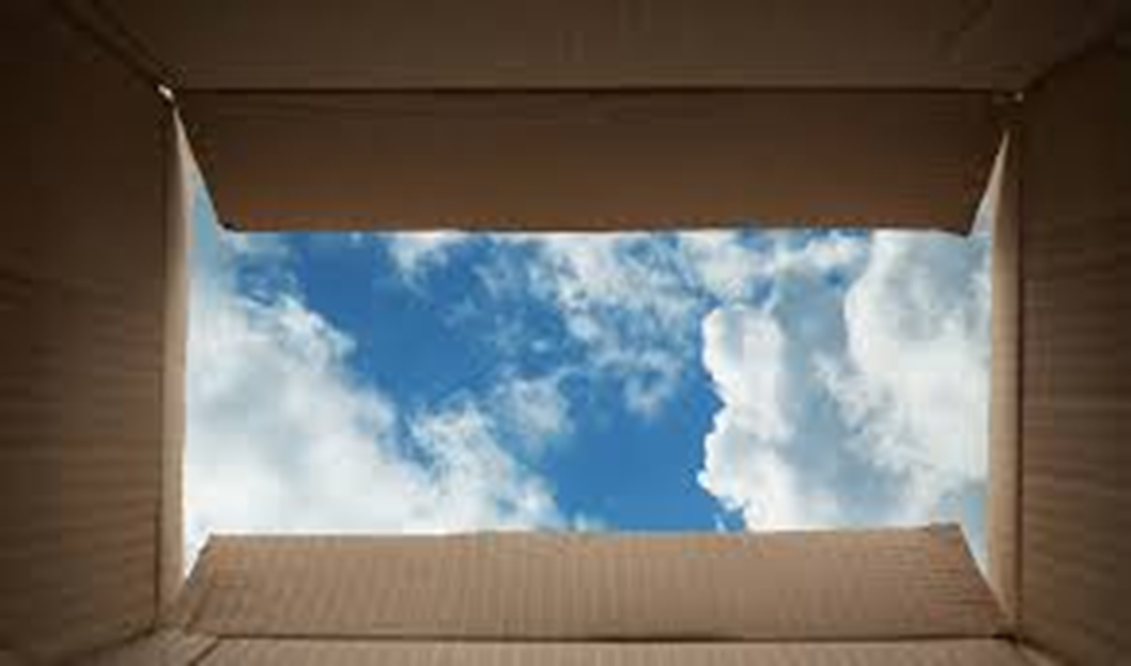
Implications Romans 10:14
How then will they call on Him in whom they have not believed?
How will they believe in Him whom they have not heard?
And how will they hear without a preacher?
How will they preach unless they are sent?
Notes:
Implic = G Pulls Us OUT of R BOX → 2 CARE
**“Believed…” =DECIS. 2 Trust → ~EMOTIONAL
**“Heard” = Comes from OUTSIDE Fallen Heart
**“Preacher” = PERSONAL CONTACT → Struggle!
**“Sent” = Comissioned by WHOM? → AP: ASK ppl!

Slide 17

God’s Commission Our Privilege
Just as it is written, “How beautiful are the feet of those who bring good news of good things!”
From Isaiah 52:7
How lovely on the mountains are the feet of him who brings good news,
Who announces peace
And brings good news of happiness,
Who announces salvation,
And says to Zion, “Your God reigns!”
Notes:
** “Good News” → Cf. w/ EVENING News
AP: “Announce Peace” = R #1 JOB
AP: Some1 Suffering? → ~Jst Empathize!

Slide 18
God’s Commission Unbelievable Work!
Romans 10:16 (NASB) 16 However, they did not all heed the good news; for Isaiah says, "LORD, WHO HAS BELIEVED OUR REPORT?"
Notes:
IL: Alan H. → #1 Rsn. Ppl ~Believe= “2 Gud…”
AP: Explain Why G ~Need 2 Sell Salvation

Slide 19
God’s Commission Our Strength!
Romans 10:17 So faith comes from hearing, and hearing by the word of Christ.
Notes:
WORD = Prophecies: Son. David & GOD & “Build…Temple”
(=Is.9)

Slide 20
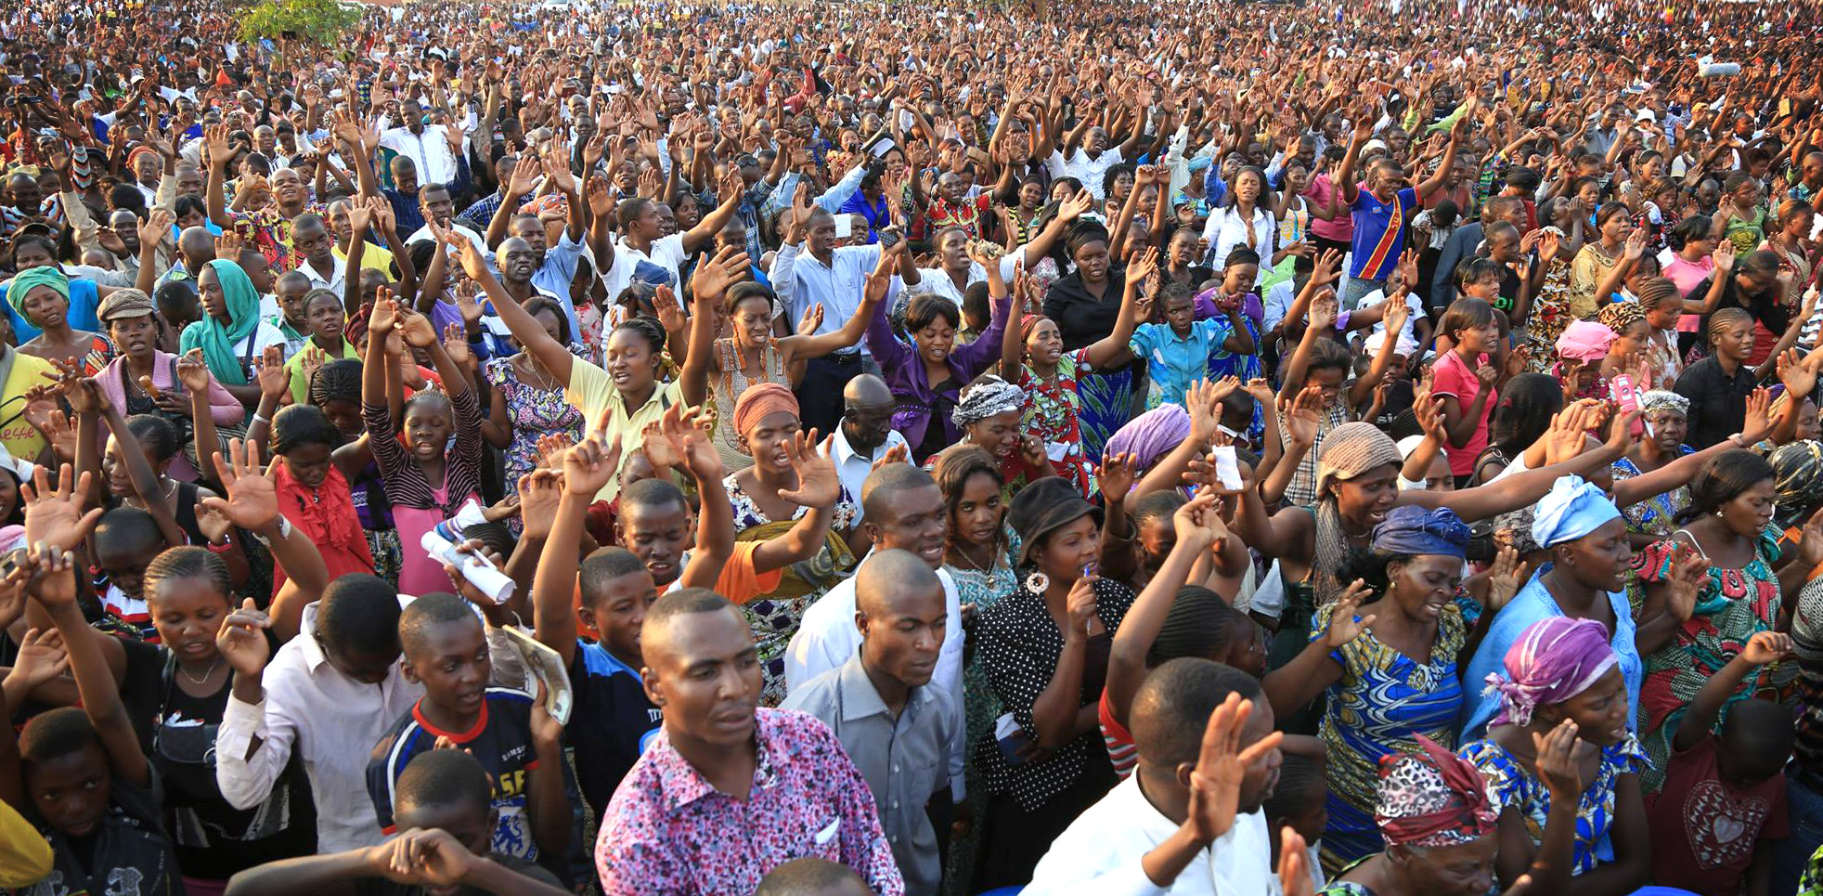
God’s Commission Our Freedom!
Romans 10:18 But I say, surely they have never heard, have they? Indeed they have; "THEIR VOICE HAS GONE OUT INTO ALL THE EARTH, AND THEIR WORDS TO THE ENDS OF THE WORLD."
Notes:
Harvest = KOG →
AP: Freedom Frm the **Cultural BOX
IL: the Joy of EVE

Slide 21
God’s Commission Our Role as Prophets!
Romans 10:20 (NASB) 20 And Isaiah is very bold and says, "I WAS FOUND BY THOSE WHO DID NOT SEEK ME, I BECAME MANIFEST TO THOSE WHO DID NOT ASK FOR ME."
Acts 1:8 but you will receive power when the Holy Spirit has come upon you; and you shall be My witnesses both in Jerusalem, and in all Judea and Samaria, and even to the remotest part of the earth."
Notes:
Have 2 PROCLAIM!! → Authority! Pwr HS!
IL: Isaiah: “How beautiful…feet” → KILLED!

Slide 22

God’s Commission Our Love & Patience!
Romans 10:21 But as for Israel He says, "ALL THE DAY LONG I HAVE STRETCHED OUT MY HANDS TO A DISOBEDIENT AND OBSTINATE PEOPLE."
Romans 10:10 for with the heart a person believes, resulting in righteousness, and with the mouth he confesses, resulting in salvation.
Notes:
HARD → Reaching People’s HEARTS
**“Confesses…SALVATION” = “Deliverance / Sanctif / Growth”
= New Life Outside R Boxes

Slide 24
God Reaches INTO Our Boxes to Save
“you will be saved”
Romans 10:11 For the Scripture says, "WHOEVER BELIEVES IN HIM WILL NOT BE DISAPPOINTED."

